Slide 1
Psychological Phenomena Hindering Effective Altruism
Jason Nemirow
Harvard University
TLYCS 2016-10-22
Notes:
Hi, I’m Jason Nemirow,
As I mentioned, I'm a G3 here in Harvard Psychology department.
Everyone in this room knows that getting people to give effectively
is depressingly difficult, so I’d like to start on a positive note by reminding myself (and you) that >>

Slide 2
We give
Private donations
$358,000,000,000
Volunteerism
8 billion man-hours
Charitable organizations
1,507,231 registered nonprofits
(National Philanthropic Trust, 2015; Giving USA, 2015;
National Center for Chartable Statistics, 2015)
Notes:
We Give
>> In 2015, Americans donated
>> $358,000,000,000, which is roughly ~3% GDP
>> and Volunteered
>> 8 billion man-hours, which is roughly ~1% Hours spent working
>> these gifts were funneled into nonprofit organizations, of which there are
over
>> 1.5 million ACTIVE in the US today

Slide 3
Most gifts could be more effective
Charities differ wildly in effectiveness
GiveWell estimates: 100x – 1000x
Yet effectiveness appears to be uncorrelated with dollars received
Correlation between financial efficiency and dollars received: r = .002
(GiveWell, 2016; Oppenheimer & Olivola 2011)
Notes:
Of course, all charities are not created equal
>> Some are vastly more effective than others.
>> In fact, rigorous charity evaluators — like GiveWell — estimate that
differences of 100X – 1000X are common
But to the disappointment of those interested in maximizing social welfare,
>> Effectiveness doesn’t track popularity with donors
Using ratings of financial efficiency and transparency as a proxy for efficacy
>> Daniel Oppenheimer and Christopher Olivola, observed a correlation of
.002

Slide 4
Why?
Notes:
Why?
Why are donors seemingly insensitive to effectiveness >>

Slide 5
Maybe donors simply lack information?
(Money for Good, 2010)
Notes:
The most obvious explanation to rule out is that donors simply lack the information.
We can ask, would donors give effectively if such data were readily available?
>> Studies from Hope Consulting (and others) suggest not.
>> While 85% of donors report caring about performance,
>> Only 30% do any research
>> Only 20% research performance
>> And Only 1–in–7 of those — or 3% of donors — gives BASED on relative performance.
…
That is,
even when donors have information about effectiveness,
remarkably few choose to give to on that basis.

Slide 6
Maybe donors simply lack information?
(Money for Good, 2010)
Notes:
The most obvious explanation to rule out is that donors simply lack the information.
We can ask, would donors give effectively if such data were readily available?
>> Studies from Hope Consulting (and others) suggest not.
>> While 85% of donors report caring about performance,
>> Only 30% do any research
>> Only 20% research performance
>> And Only 1–in–7 of those — or 3% of donors — gives BASED on relative performance.
…
That is,
even when donors have information about effectiveness,
remarkably few choose to give to on that basis.

Slide 7
People do not value all lives equally
Notes:
While not much is known about our insensitivity to effectiveness per se,
psychologists and behavioral economists have been exploring a related phenomenon for decades, that is,
>> people do not value all lives equally.
But before we review those findings, it’s worth reminding ourselves that >>

Slide 8
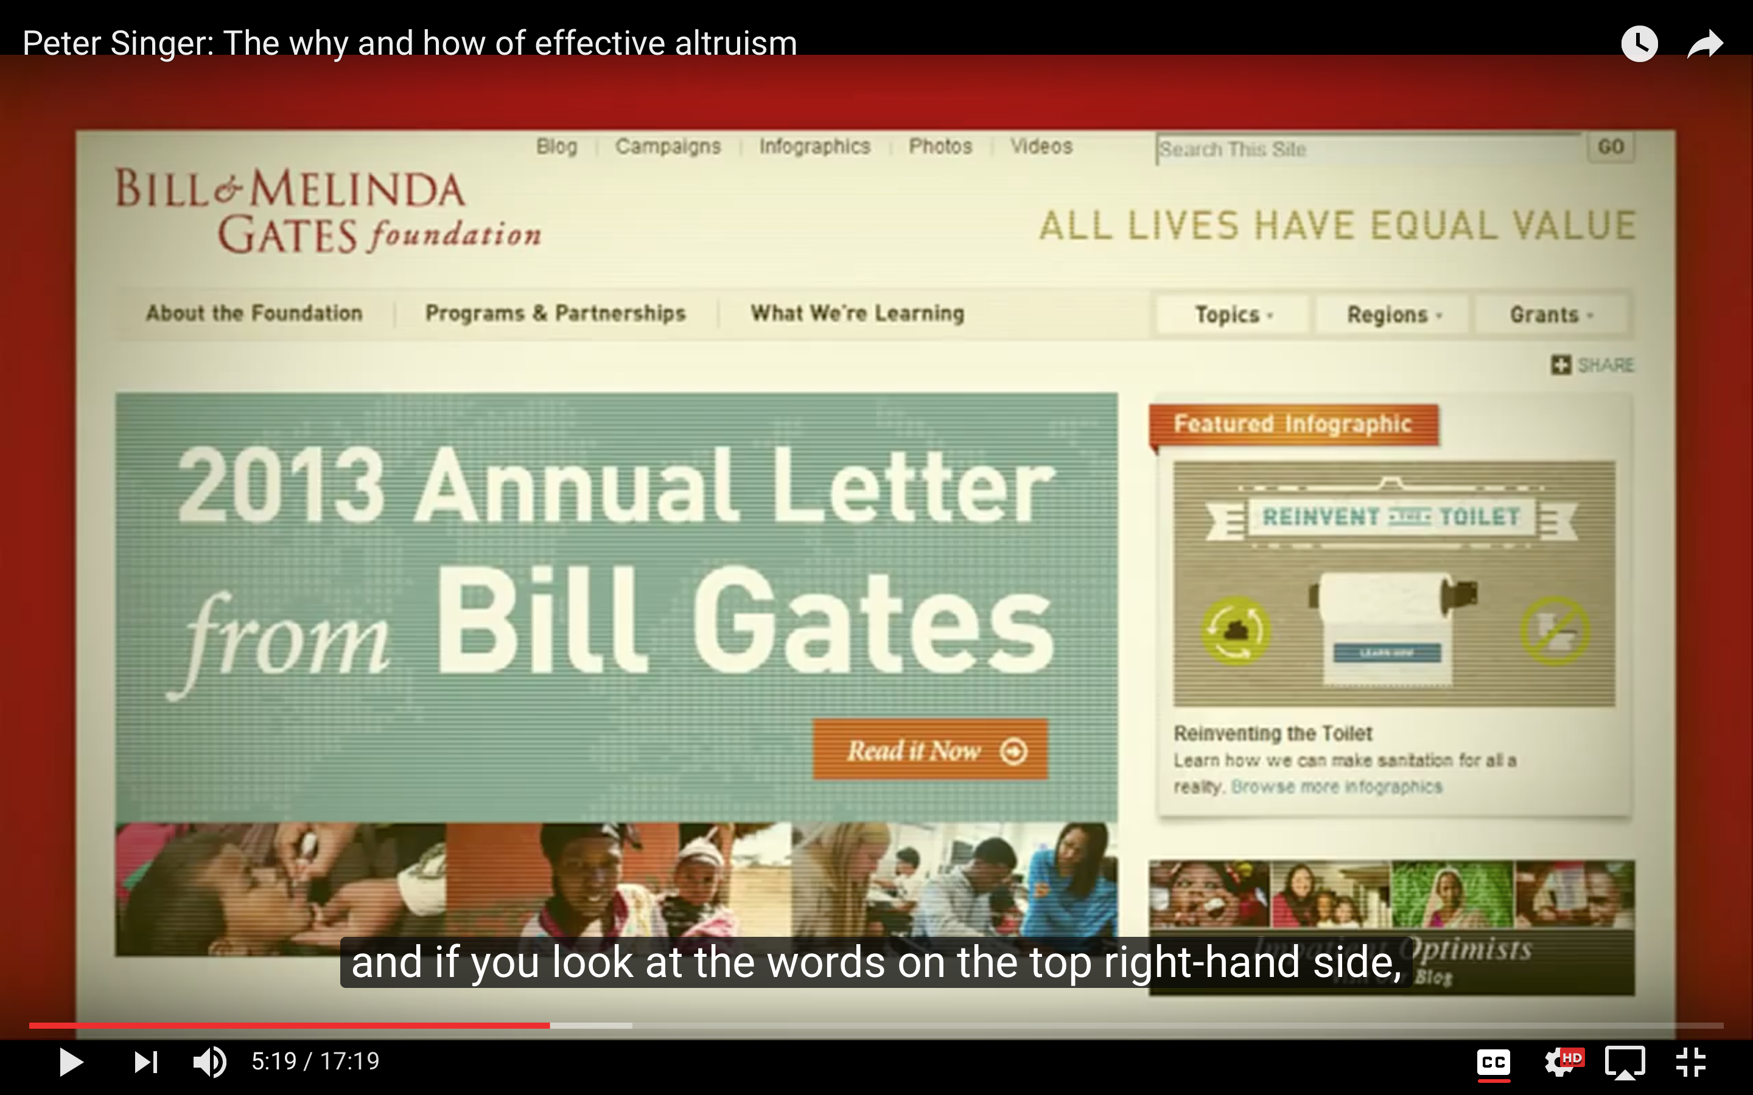
Gates Foundation homepage circa 2013
Notes:
The normative position that people should value lives equally isn’t ubiquitous in the charitable world.
On the contrary, it’s a distinguishing feature of a select few charities, including the Gates Foundation, >>
which Peter Singer pointed out in his 2013 TED talk introducing the Effective Altruism to the public.

Slide 9
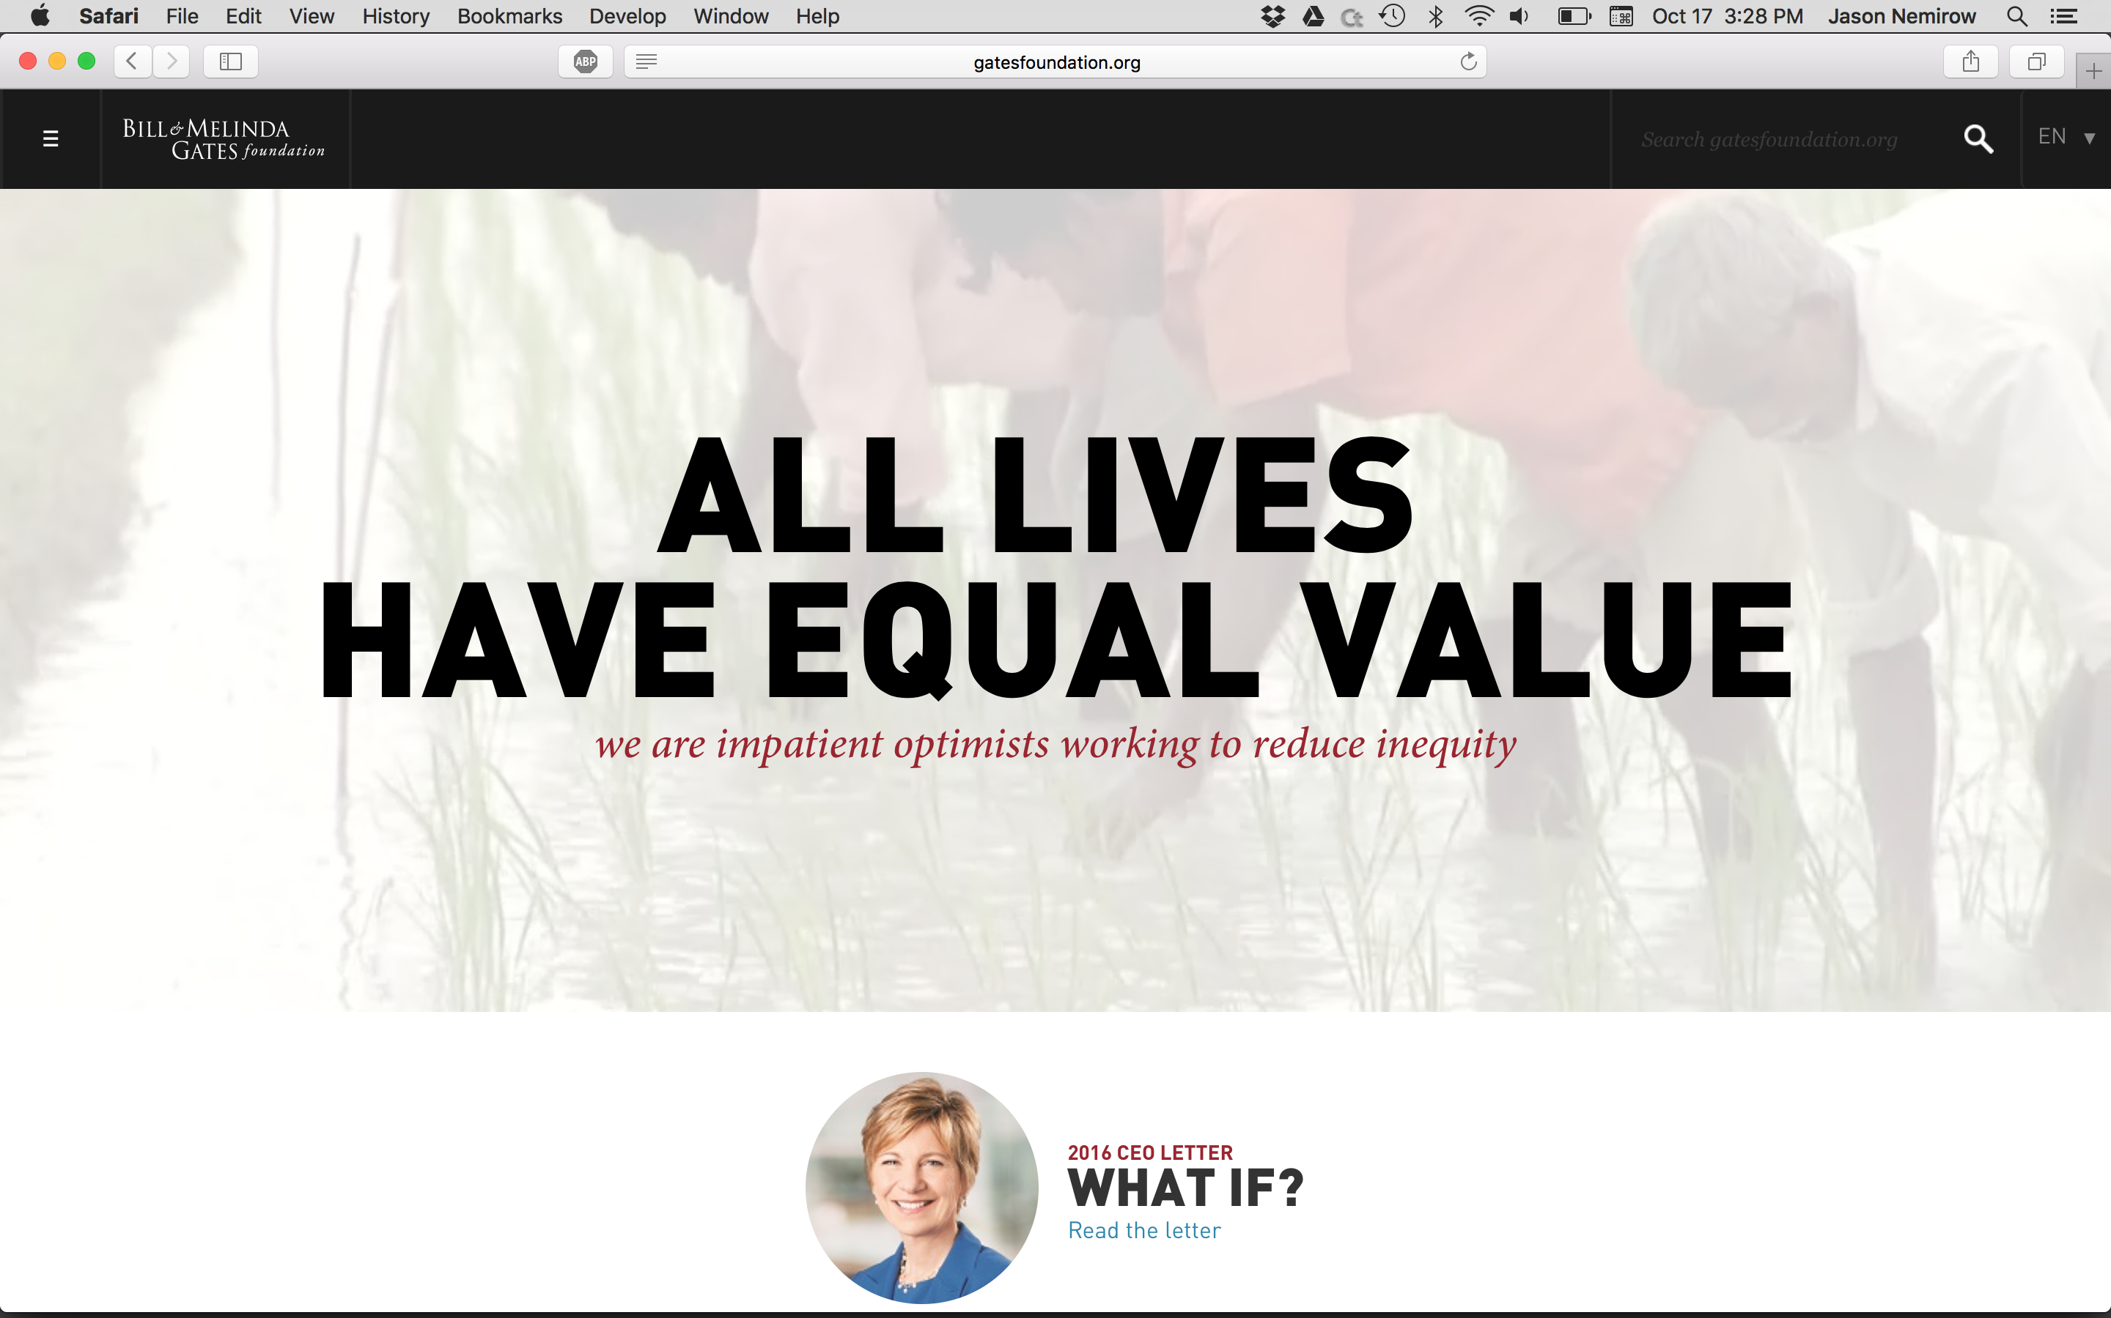
Gates Foundation homepage today
Notes:
These days, that same message features a bit more prominently on the Gates Foundation home page. >>
But the concept remains impossible for most of us to internalize.

Slide 10
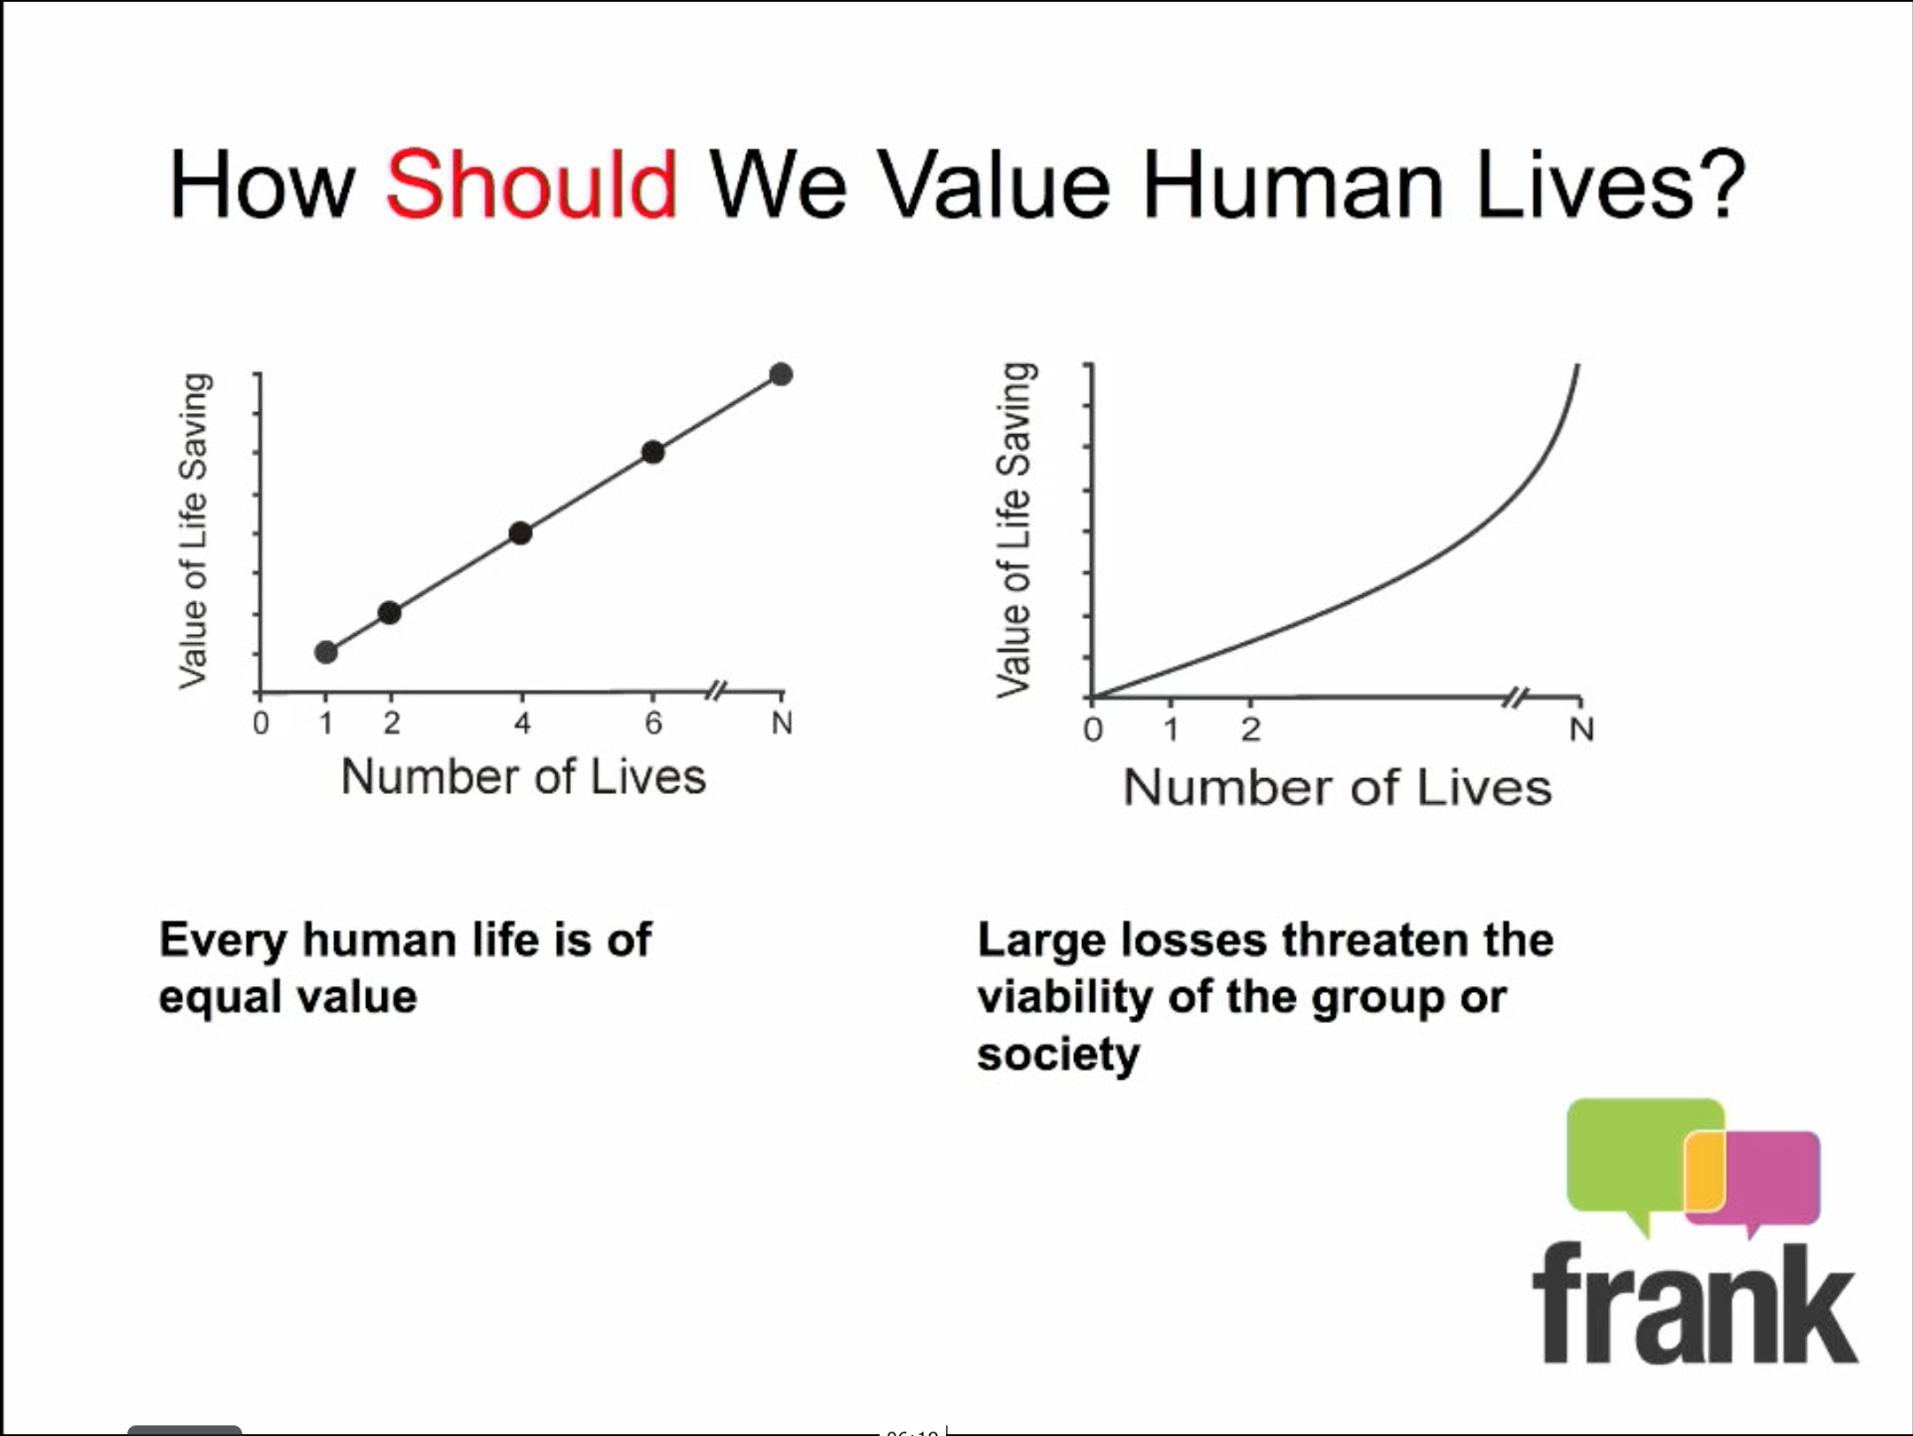
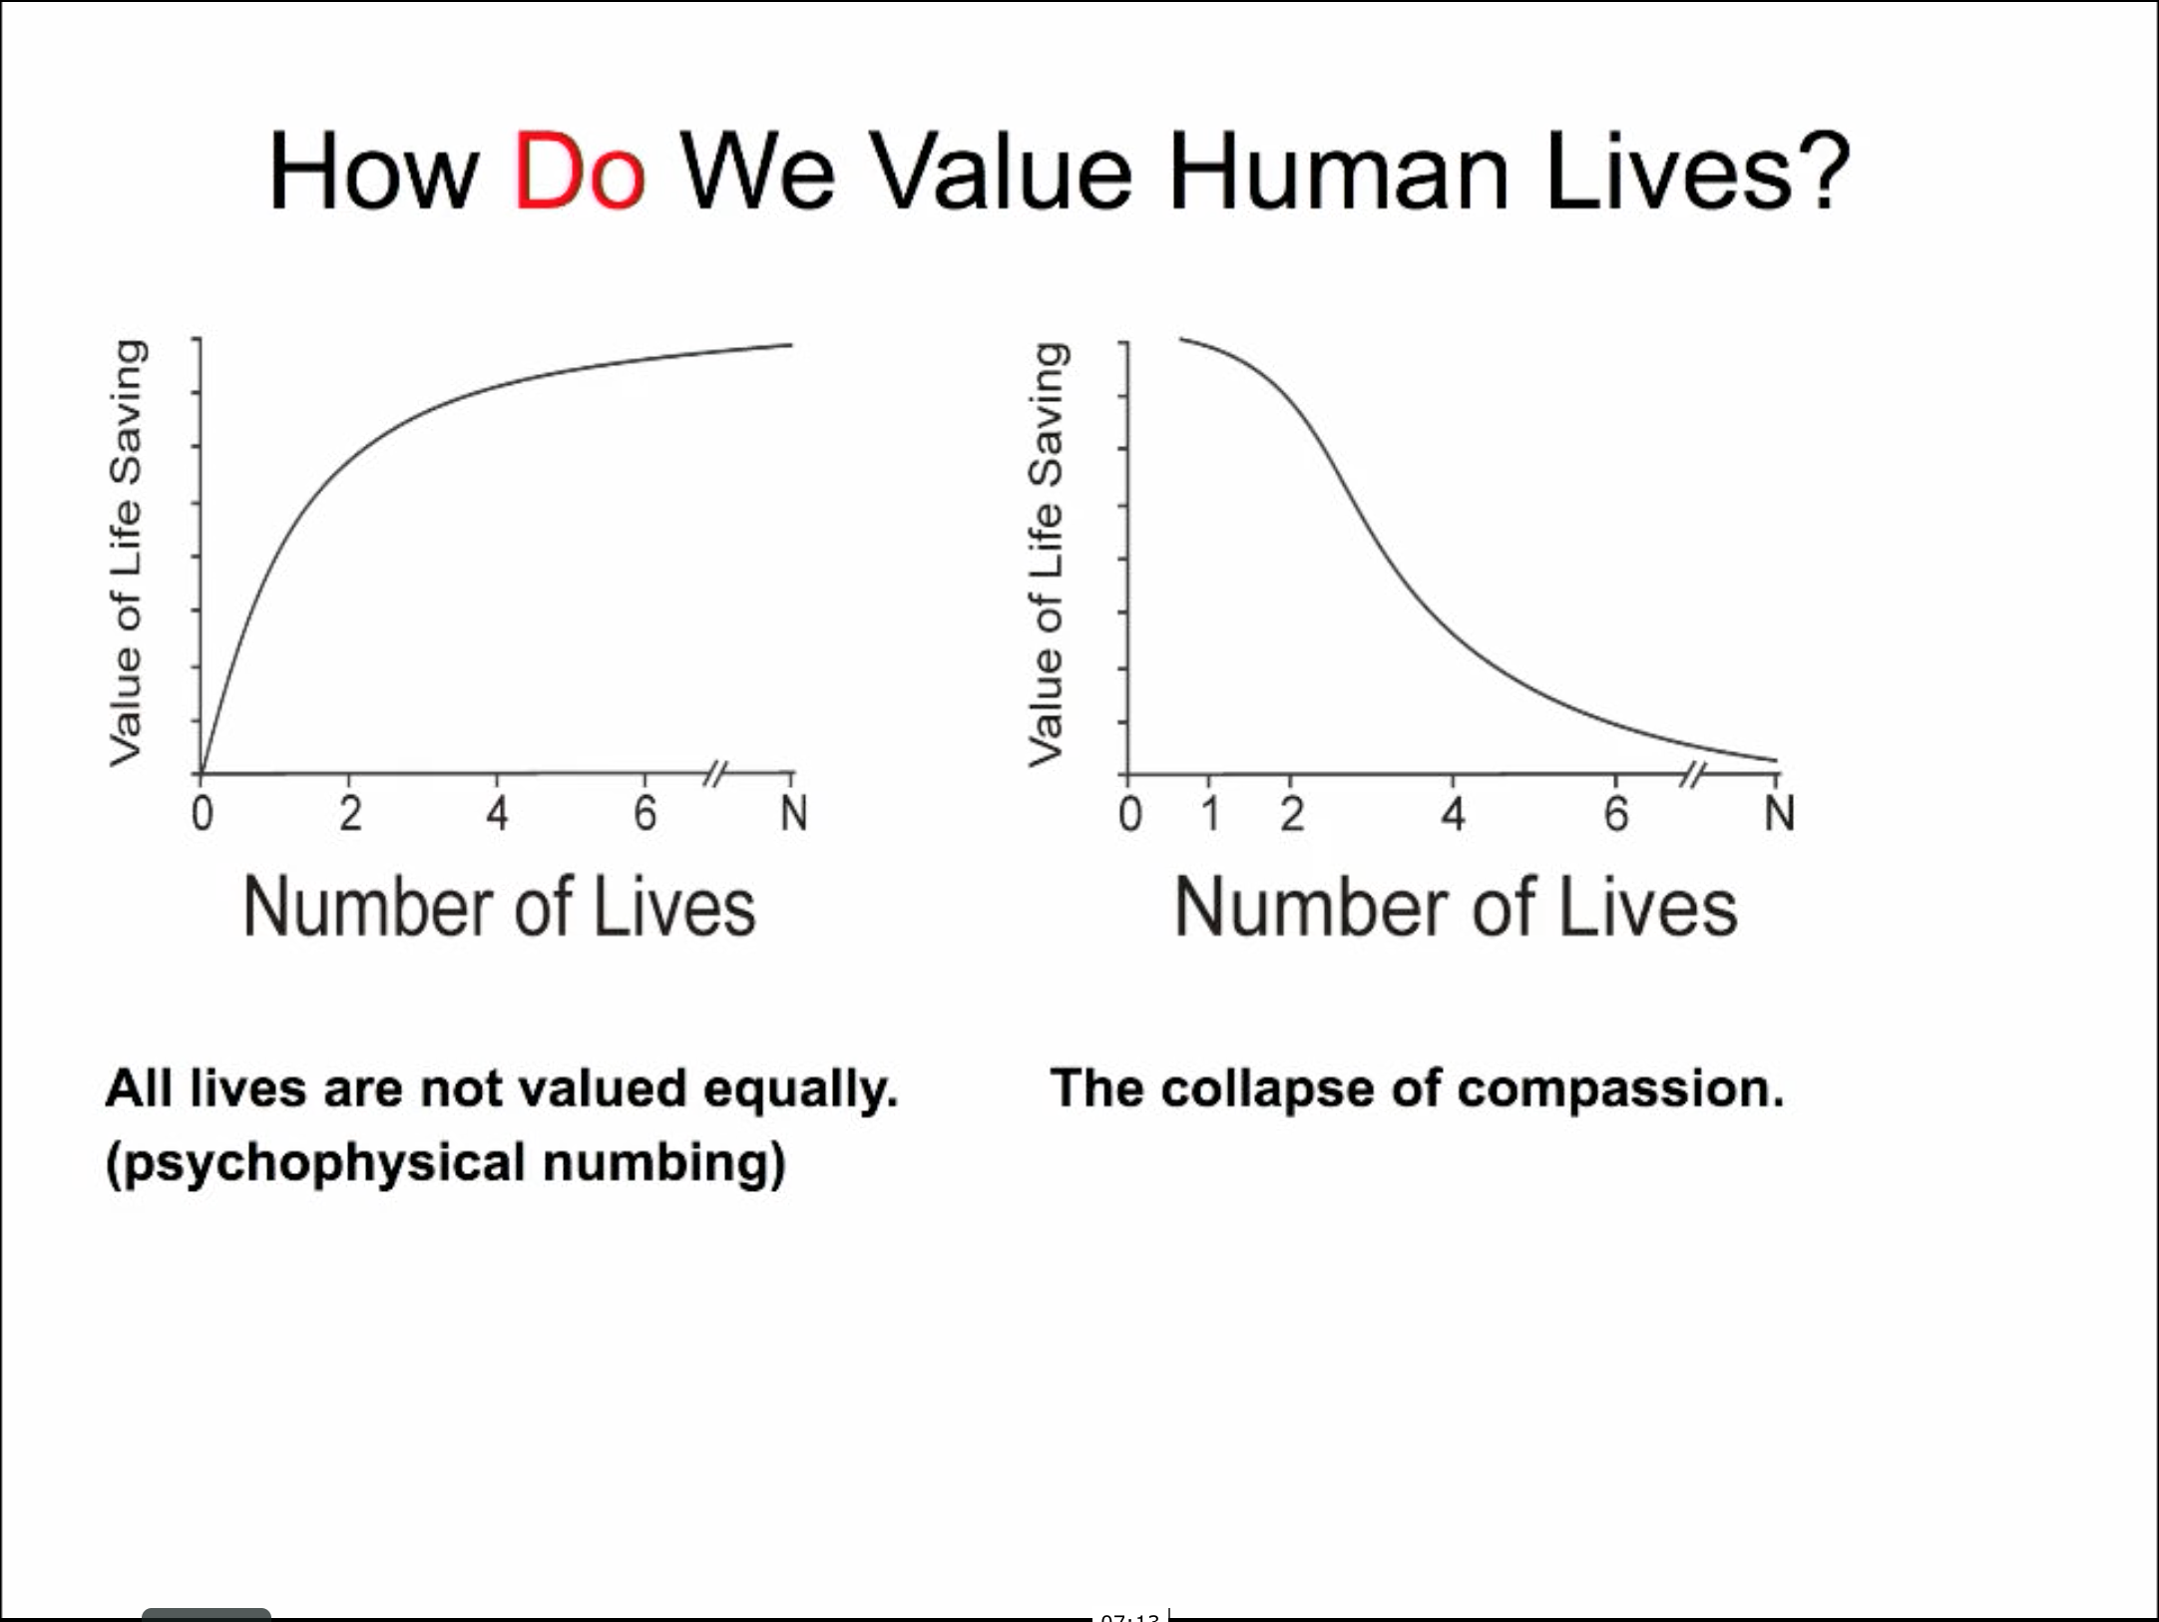
Notes:
I'm relatively new to this literature, but Paul Slovic is a true expert in how people value human lives, and in a talk delivered earlier this year, he summarized decades worth of findings in four graphs:
>> The first two depict normative models -- of how we should value saving human lives.
- One linear, giving equal value to each additional life saved
- One exponential, suggesting that existential threats deserve special attention
>> The second two are descriptive models -- of how we actually value saving human lives.
- At best: generosity gradually falls off
- At worst: it collapses altogether
To my mind, these graphs succinctly explain why EA has been fighting an uphill battle since its inception — it’s core premise — that all lives have equal value — is completely out of line with people’s default psychology.
In that light, it's impressive that appeals to reason and provocative thought experiments have convinced as many EAs as they have.

Slide 11
Evidence people do not value all lives equally:
Scope Insensitivity
Desvousges & Co., 1992; Baron & Greene, 1996
The Proportion Effect
Featherstonhaugh & Co., 1997, Slovic, Johnson, & Friedrich, 1997; Friedrich & Co., 1999
The Identifiable Victim Effect
Schelling, 1968; Jenni & Loewenstein, 1997; Small & Loewenstein 2003, 2005; Kogut & Ritov, 2005
Notes:
Now I’d like to zoom in on three examples of how our default psychology biases us to values lives unequally.
>> Scope insensitivity
>> The Proportion effect
>> The identifiable victim effect
------------------------------------------------------
There’s abundant evidence that people do not value all lives equally. I'll focus here on three well-established findings:
>> Scope insensitivity, the observation that the scope of a problem does not affect how much people are willing to pay to solve it
>> Proportion effect, that people favor interventions that benefit a large proportion of those afflicted compared to larger number of absolute lives.
>> The identifiable victim effect: that people are more willing to aid identified individuals than unidentified or statistical victims.
Identifiable victim effect survives even when controlling for the size of the reference group: Small and Loewenstein (2003) and Kogut and Ritov (2005a)
[Alt framing: People favor interventions expected to benefit a larger proportion of the afflicted compared to large number of absolute lives.
People are more sensitive to proportions than absolute numbers of lives
Baron, 1997; Jenni & Loewenstein, 1997; Featherstonhaugh, Slovic, Johnson, & Friedrich, 1997; Fried- rich et al., 1999…

Slide 12

1. Scope Insensitivity
Notes:
Scope insensitivity is the observation that the size of a problem doesn’t always affect how much people are willing to pay to solve it.
For example, one study found no difference in subjects’ willingness to pay to save 2,000, 20,000, or 200,000 birds — when these interventions were evaluated separately.
One takeaway here is that drawing attention to the size of the problem isn’t a reliable advertising strategy.

Slide 13

2. The Proportion Effect
>
Notes:
A second piece of evidence that people value lives unequally is the proportion effect — that the subjective value of saving a fixed number of lives is greater for a small tragedy than for a large one.
In other words, people see 10 deaths in a reference group of 100 as a tragedy, while 10 deaths in a reference group of 1,000,000 is just ‘‘a drop in the bucket.’’
An early study of this effect found that people were less willing to aid 1500 refugees as the size of the camps' at-risk population increased. >>

Slide 14
2. The Proportion Effect
>
Notes:
When evaluating interventions separately, The proportion effect can even lead people to favor interventions that benefit a large proportion of those afflicted over a larger number of absolute lives.
For example, one study found people were more likely to support a medical intervention expected to save 9,000/15,000 lives compared to one expected to save ten times as many 100k/290k
The effect has been replicated across numerous interventions —from genocide prevention to the adoption of antilock brakes. >>

Slide 15

3. Identifiable Victim Effect
>
Notes:
A third piece of evidence that people value lives unequally is the identifiable victim effect: That people are more willing to aid identified individuals than unidentified or statistical victims.

Slide 16
Can people be taught to value lives consistently?
Notes:
Last year, in a talk at Google, Peter Singer singled out the identifiable victim effect as an example a psychological bias that we should try to combat though public education.
>> Last month I realized that Small, Lowenstein & Slovic attempted to do exactly that in series of studies published in 2007; namely, they tested whether they could get people to value lives more consistently by teaching them about the psychological bias toward identifiable victims before asking them to donate.

Slide 17


Debiasing Intervention
Control
Notes:
Their study looked like this:
>> To begin, half of subjects were randomly assigned to read about the identifiable victim effect (and the neglect of statistical victims).
>> Subjects in the statistical victim condition then read a solicitation letter composed of facts pulled from Save The Children's website.
Facts like: “Food shortages in Malawi are affecting more than 3 million children.”
>> Subjects in the identifiable victim condition instead read a solicitation letter that included a picture of a poor African girl named Rokia and a description of her plight.

Slide 18
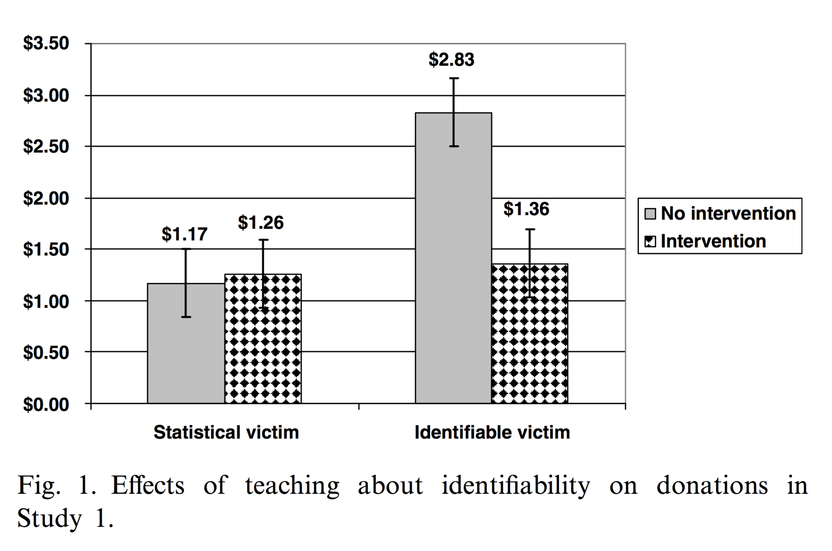
Explicit debiasing efforts
(Small, Loewenstein, & Slovic, 2007)
Notes:
So, what happened to generosity when people were explicitly informed about the bias toward identifiable victims?
These gray bars represent mean donations in the control condition:
As expected, people gave considerably more to the identified victim.
As for the intervention group:
>> They gave less to the identified victim
>> But failed to give more to statistical victims
In the words of the authors,
"The debiasing efforts had perverse effects:
… resulting in an overall reduction in caring and giving."

Slide 19
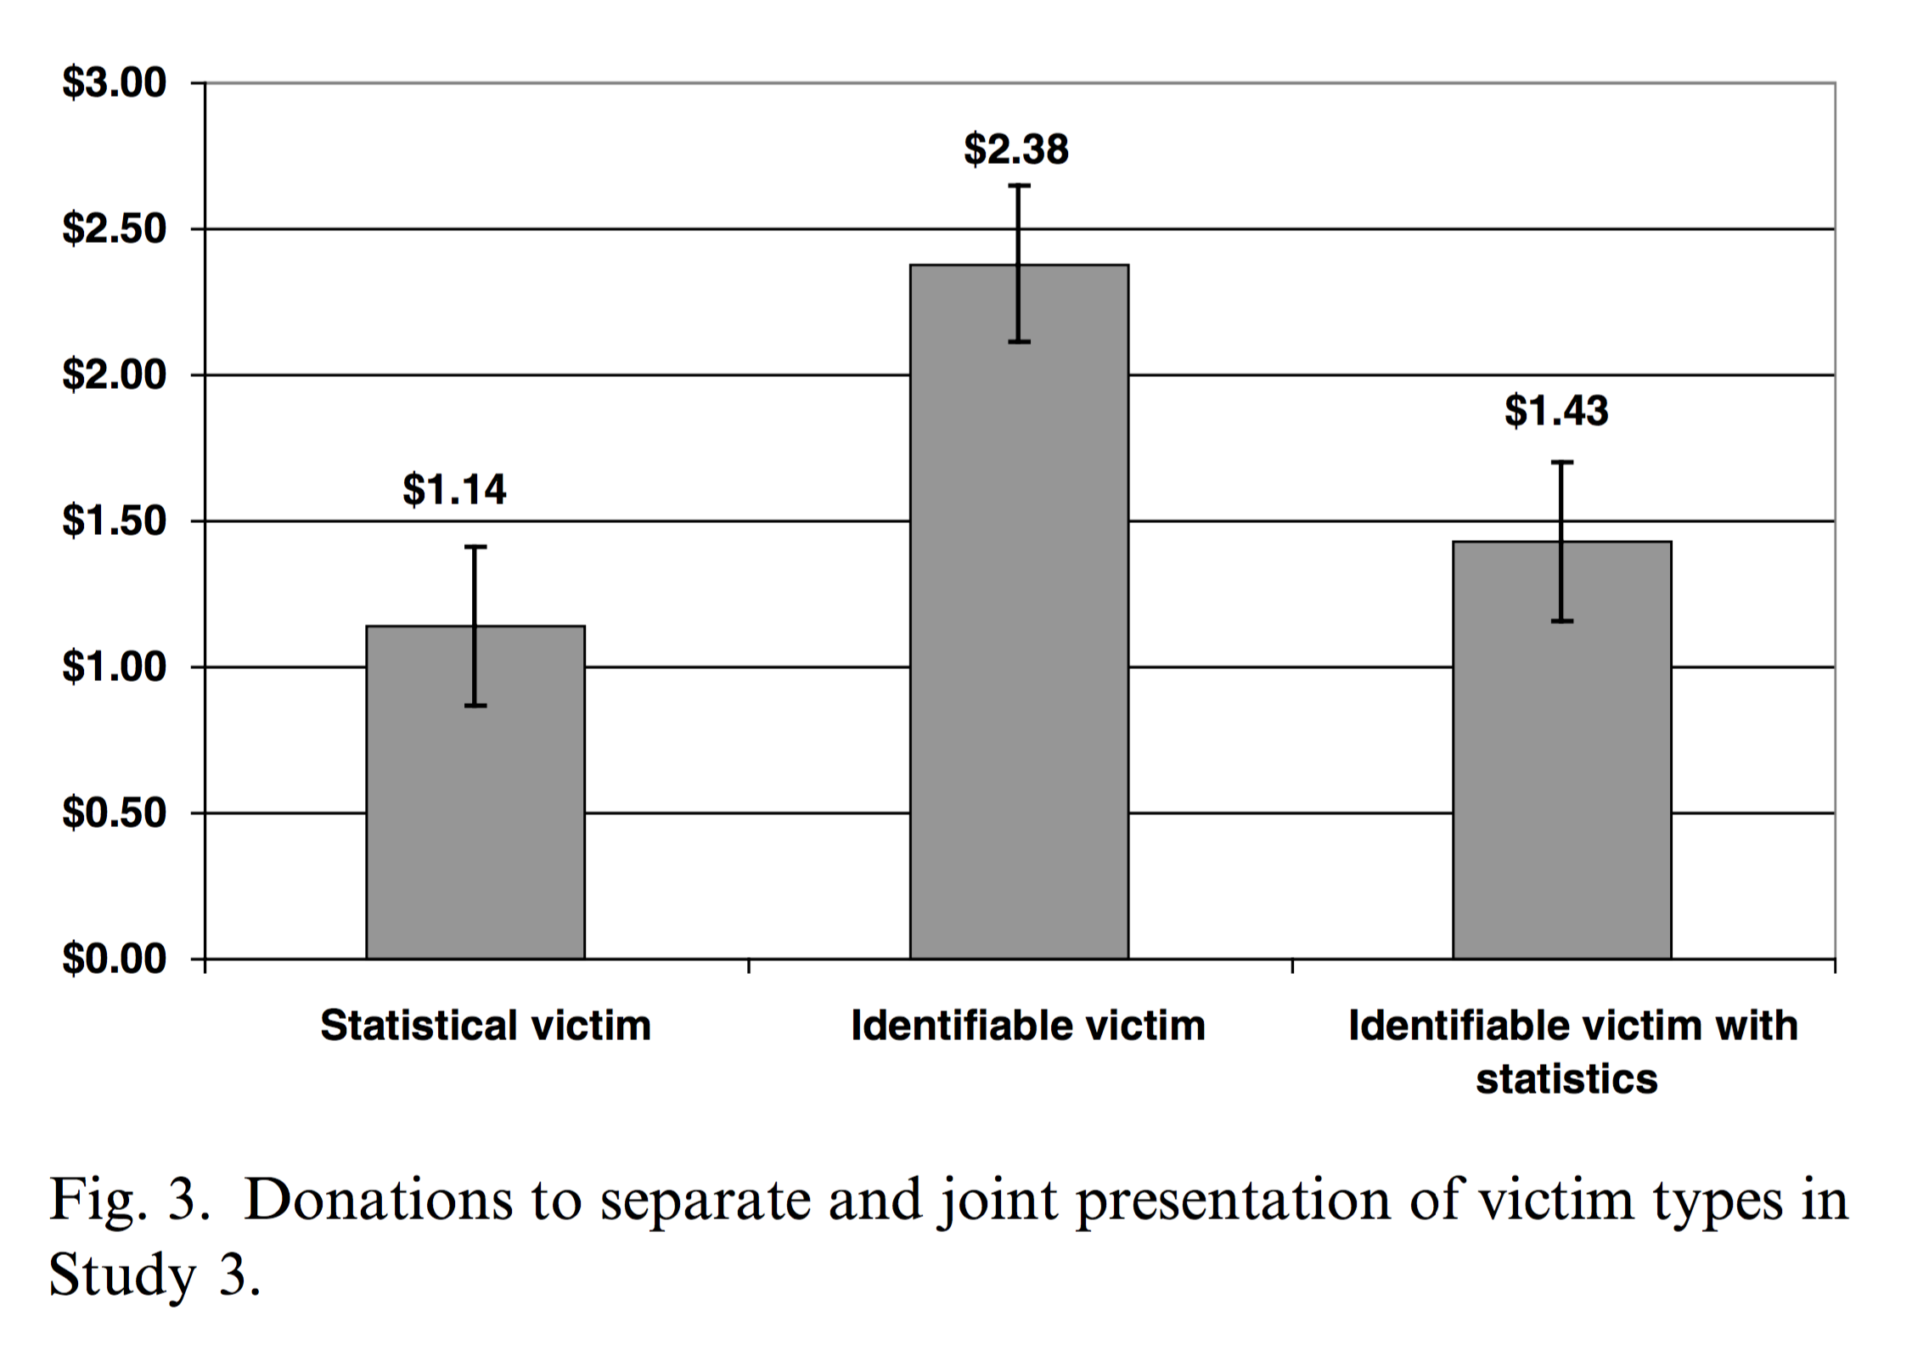
Implicit debiasing efforts (adding statistics)
(Small, Loewenstein, & Slovic, 2007)
Notes:
In a separate study, Small & Co. also tried to implicitly debias identifiability by pairing an identified victim with statistics.
Sadly, instead of having a synergistic effect, the addition of statistics suppressed generosity
>> Back down to roughly the level elicited by presenting prospective donors with statistics alone.

Slide 20
Conclusions from Small & Co.
Bias is pervasive and subborn, but it can be harnessed for good (Poster child, Singer’s pond example)
Notes:
What lesson can we draw from Small & Co. Study?
Although identifying a victim can lead to uneven distributions, it still generates more aid than any other pitch. Thus, giving to identified individuals might constitute a ‘‘second best’’ optimum.
Rather than fight this powerful psychological bias, charities the world over use it to their advantage by employing poster children to raise money for general causes. Much as Peter Singer himself leveraged the identifiable victim effect in his famous pond example to recruit countless EAs.
>> I think the broader point here is that it's really, really hard to educate people out of these biases — interventions rarely work and sometimes backfire. So, if we can’t beat ‘um, let’s figure out how to use ’um.
Along those lines, if we want EA to grow, I think we're going to need a better understanding of the default psychology that motivates people to give.

Slide 21
Why do we give?
Proximate theories:
Want to experience a “warm glow” (Andreoni, 1990)
Aspire to “do the right thing” (Dawes & Thaler, 1988)
Need to view ourselves as compassionate (Schlenker, 1980)
Quest for moral satisfaction (Kahneman & Knetsch, 1992)
Notes:
>> No shortage of proximate theories from psychologists and economists
that attempt to explain why we give, including:
>> That we give to experience a ”warm glow”
>> Or because we aspire to “do the right thing”
>> Or because we need to view ourselves as compassionate
>> Or perhaps we give b/c we’re on a quest for moral satisfaction >>

Slide 22
Why do we give?
Proximate theories:
Want to experience a “warm glow” (Andreoni, 1990)
Aspire to “do the right thing” (Dawes & Thaler, 1988)
Need to view ourselves as compassionate (Schlenker, 1980)
Quest for moral satisfaction (Kahneman & Knetsch, 1992)
Ultimate theories?
Notes:
While these theories are intuitive and reasonable,
they all beg the question...
THAT IS:
Why do we get a warm glow from giving?
–OR–
Why is it morally satisfying to give?
>> Ultimate theories — regardless of their particulars — posit that we give
because we get something in return.

Slide 23

Notes:
However, because charity is directed toward
non-kin from whom we expect no direct repayment, >>
how is it that charity benefits us in the long run?

Slide 24

Notes:
The answer hinges on Third party observers. >>
More specifically, reputation based theories suggest that we give because it inflates our reputation in the eyes of others.
One particular reputation-based theory, known as partner choice, posits that we give in order to signal our value as potential cooperative partners to observers
Importantly, ultimate theories don't claim these processes are necessarily conscious.
When you see someone in need,
these theories –allow– that you –genuinely– want to help,
but when you do so,
you open up the possibility that benefits will flow back to you by bolstering your reputation in the eyes of anyone who happens to obverse your good deed.

Slide 25
Convergent evidence suggests social observation increases altruism
Eckel & Grossman, 1996; Harbaugh 1998a, 1998b; Andreoni , 1988, 1990
Notes:
Reputation-based theories predict that
social observation
should make people more altruistic — a prediction that is overwhelmingly supported by experiments in the lab and field.
As Bethany will expand on in her talk, Social observation is far and away the most potent intervention for increasing altruism, yet we still don't know how to harness it to increase effective altruism.
Doing so requires a clear understanding of what observers admire in givers.

Slide 26
Why do observers esteem altruists?
Impact?
Sacrifice?
Notes:
There are two obvious dimensions along which a third party might esteem an altruist:
>> Impact delivered
>> Sacrifice made

Slide 27
Do third parties esteem impact or sacrifice?
Observers should be sensitive to signals that reveal stable features of givers
Sacrifice is easier to observe
Can be observed in the present
Whereas benefits can take time to appear
Sacrifice is a more informative signal
Directly under the giver’s control
Notes:
Impact seems the obvious choice, as it tracks the amount of good done, but if observes are more interested in learning what kind of person the donor is, they might care more about sacrifice.
>> Partner choice theories assume that people are on the lookout for the best possible cooperative partners. With this motive, observers should be sensitive to stable features of givers — things that will help predict their future behavior.
Of course, >> observers *cannot asses* what they *cannot see*, >> and sacrifice has the virtue of being easier to observe in the present, >> whereas benefits are often slow to appear
And Critically, >> sacrifice is a more informative signal of underlying cooperative disposition>>
As IT IS directly under the giver's control

Slide 28
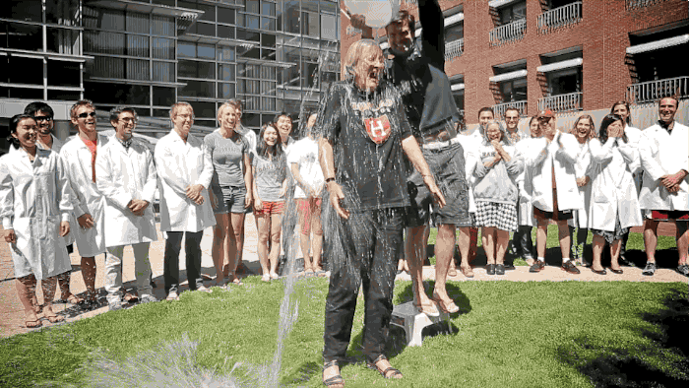

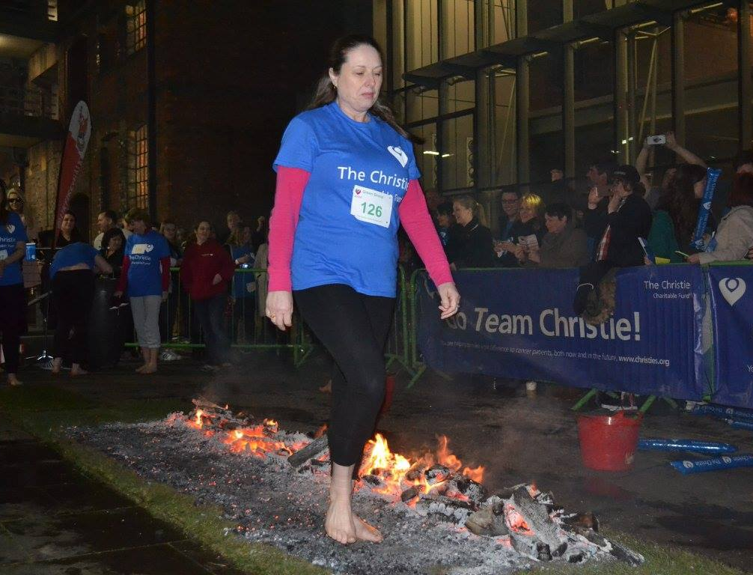

Notes:
If givers are particularly concerned with being seen as sacrificial,
that would help explain a range of otherwise puzzling charitable behaviors.
>> Like why we run for an extended period of time in hopes of curing AIDS
>> Why we jump out of planes to feed hungry kids
>> Why this woman is walking on hot coals in hopes of curing cancer
>> Why the president of Harvard, Drew Faust, is being doused with ice water
in hopes of curing ALS.
Importantly, >> none of these self-flagellatory behaviors has any direct relationship with cause they aim to help.
However, they do seem remarkably well designed to signal a willingness-to-sacrifice.

Slide 29
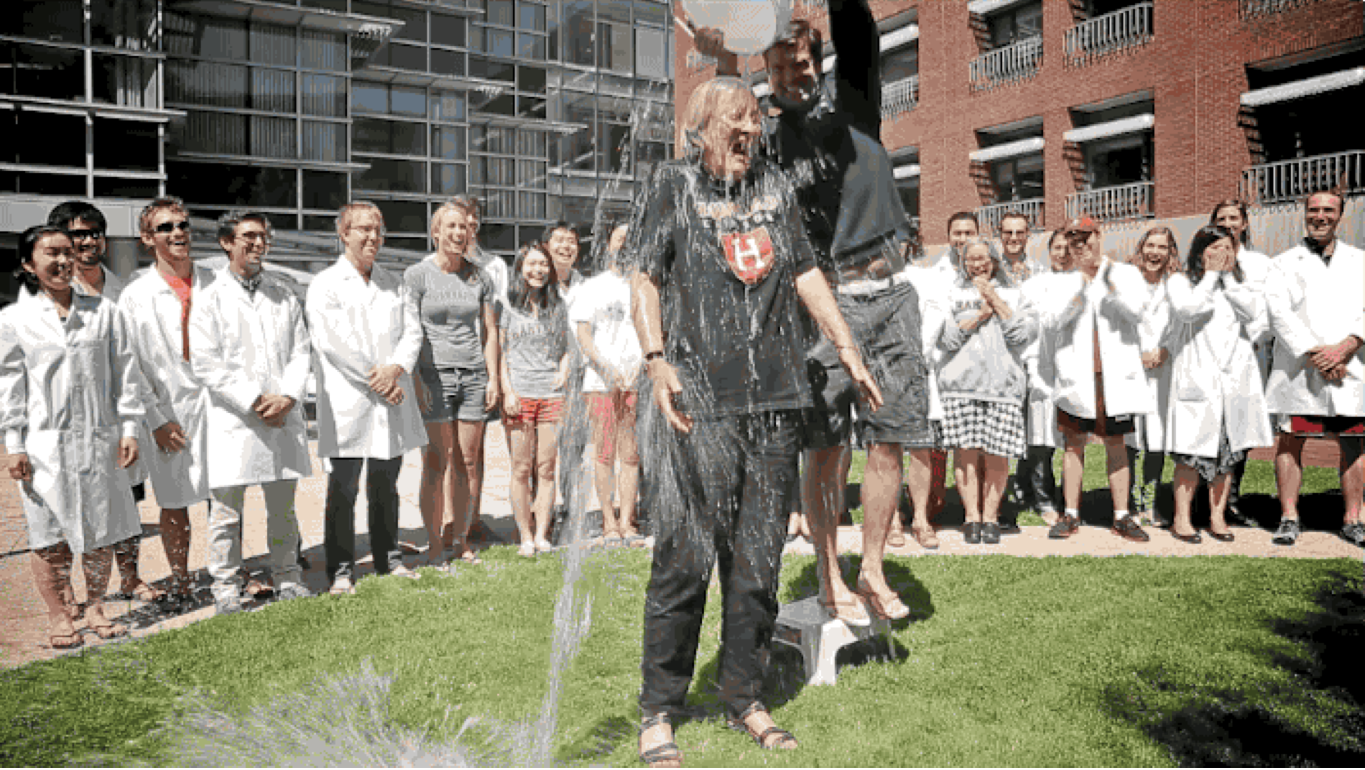
Notes:
If givers are particularly concerned with being seen as sacrificial,
that would help explain a range of otherwise puzzling charitable behaviors.
>> Like why we run for an extended period of time in hopes of curing AIDS
>> Why we jump out of planes to feed hungry kids
>> Why this woman is walking on hot coals in hopes of curing cancer
>> Why the president of Harvard, Drew Faust, is being doused with ice water
in hopes of curing ALS.
Importantly, >> none of these self-flagellatory behaviors has any direct relationship with cause they aim to help.
However, they do seem remarkably well designed to signal a willingness-to-sacrifice.

Slide 30
Study method
Manipulated:
Sacrifice made (2 Days, 10 Days)
Benefit delivered (200 Meals, 1000 Meals)
Along with two other factors:
Researched prior to giving? (No Research, Researched)
Mode of contribution (Donated, Volunteered)
Measured: third-party praise
Notes:
So, are observers particularly sensitive to sacrifice compared with other aspects of giving?
We tested this question using vignettes in __[2x2…x2….......x2]__ Factorial design__ administered between subjects:
In each condition, we asked subjects to evaluate fictitious altruists for a “Humanitarian of the Year” prize.
>> We Manipulated:
>> Personal sacrifice: operationalized here as having surrendered
(2 or 10 Days of one's time—OR—earnings)
>> Benefit delivered (200 Meals, 1000 Meals)
>> Along with two other factors:
>> Having researched effectiveness before deciding how best to give
(or not)
>> And Mode of contribution, that is, having donated, or volunteered
>> And we Measured third-party praise

Slide 31
NS
NS
NS
P < .0001
Notes:
>> So, were nominees who volunteered rated as more deserving of the award?
>> No.
>> Were nominees who researched the most effective way to contribute seen as more deserving of the award?
>> No they were not.
>> Were nominees who delivered an additional 800 meals – seen as more deserving of the award?
>> Nope.
>> Finally, were nominees who sacrificed an additional 8 days of their time—OR—earnings seen as more deserving of the award?
>> Yes, the effect was significant at the .0001 level, and boosted ratings of deservingness by 1/3 of standard deviation.
I should mention that there were no significant interactions. And we've replicated these results several times.

Slide 32
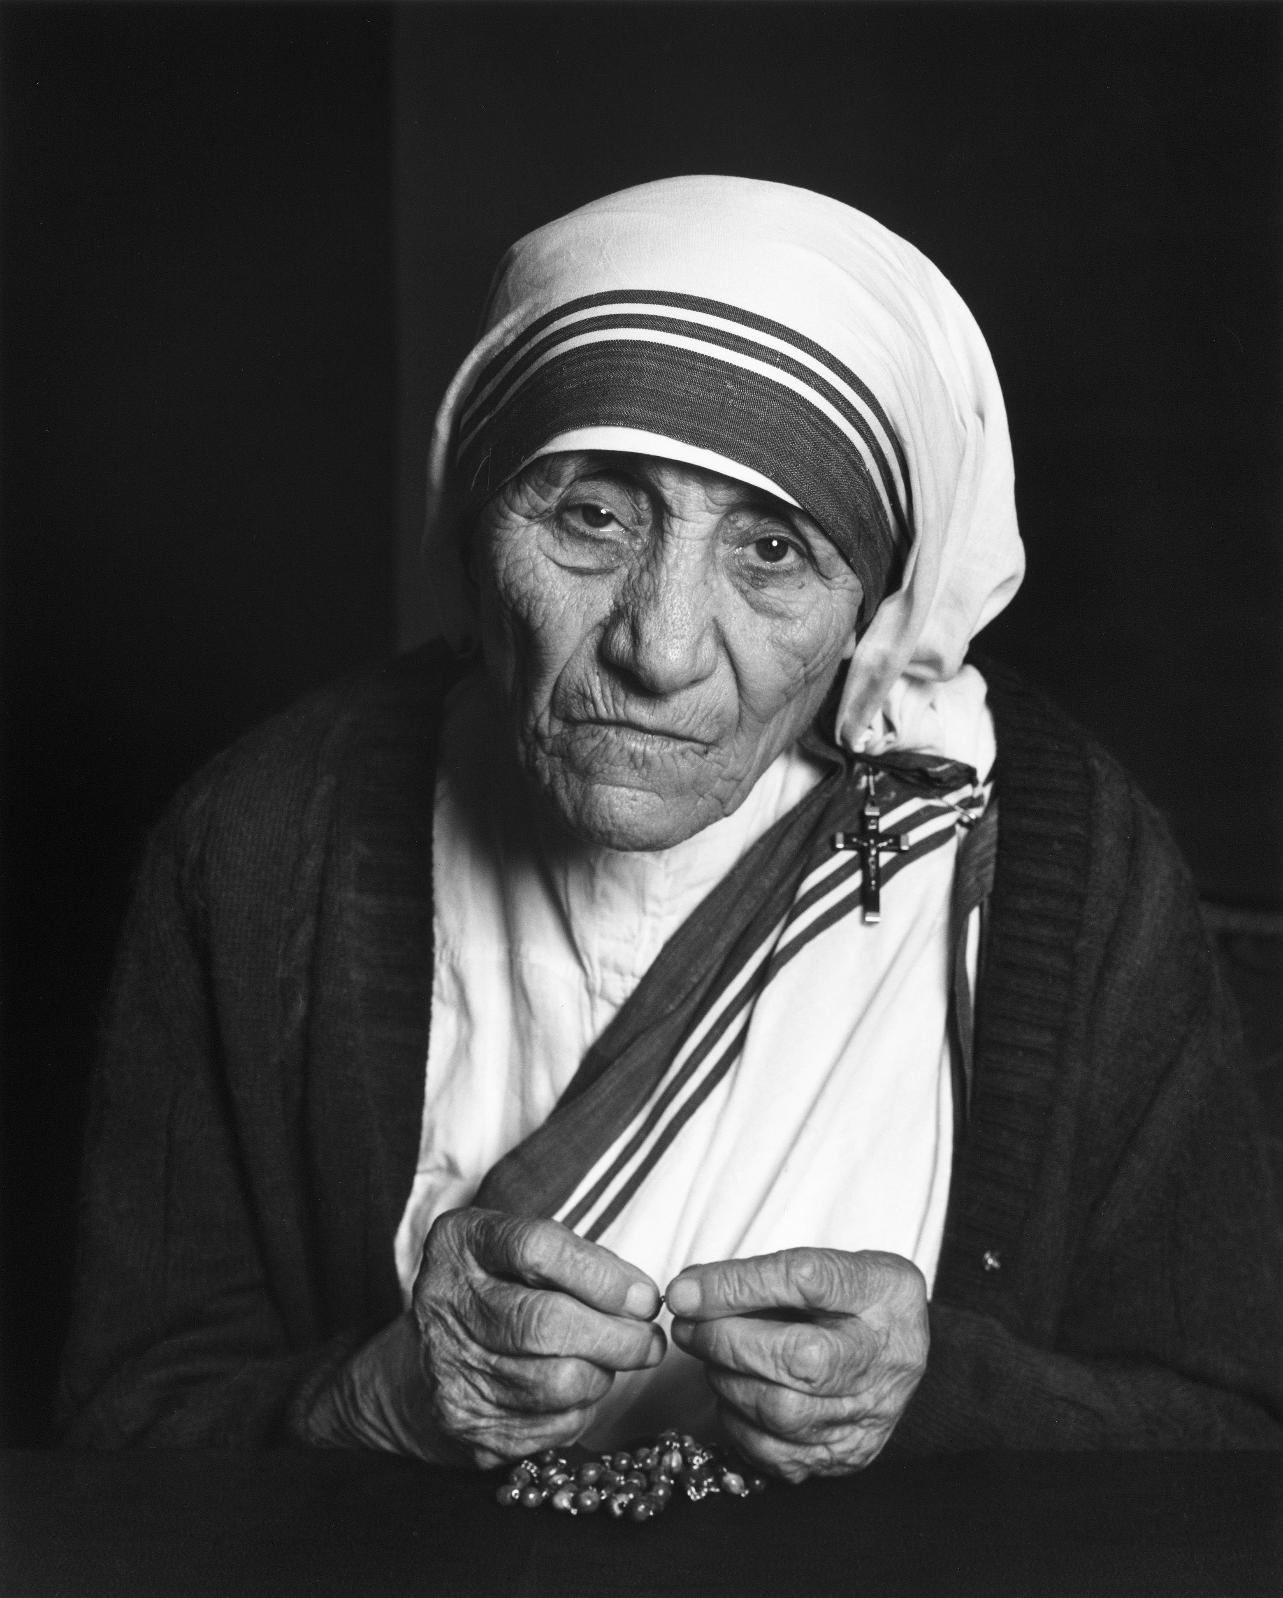
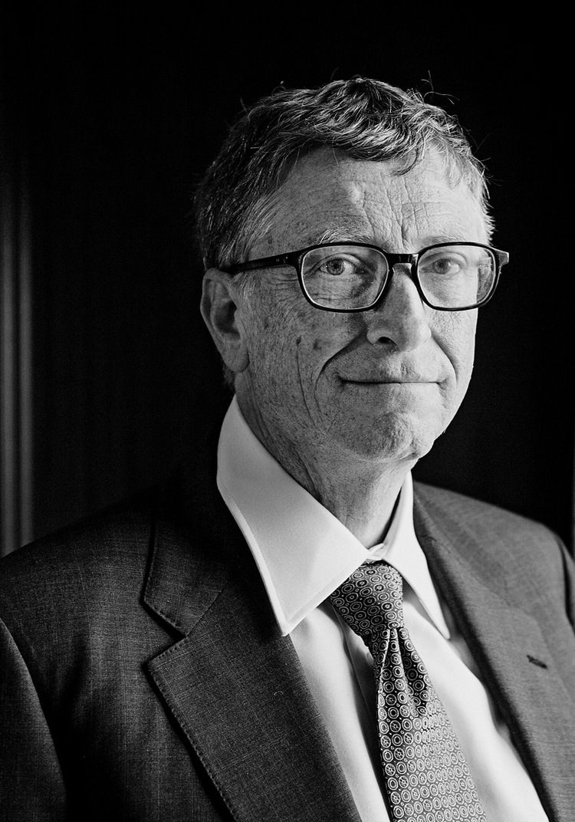
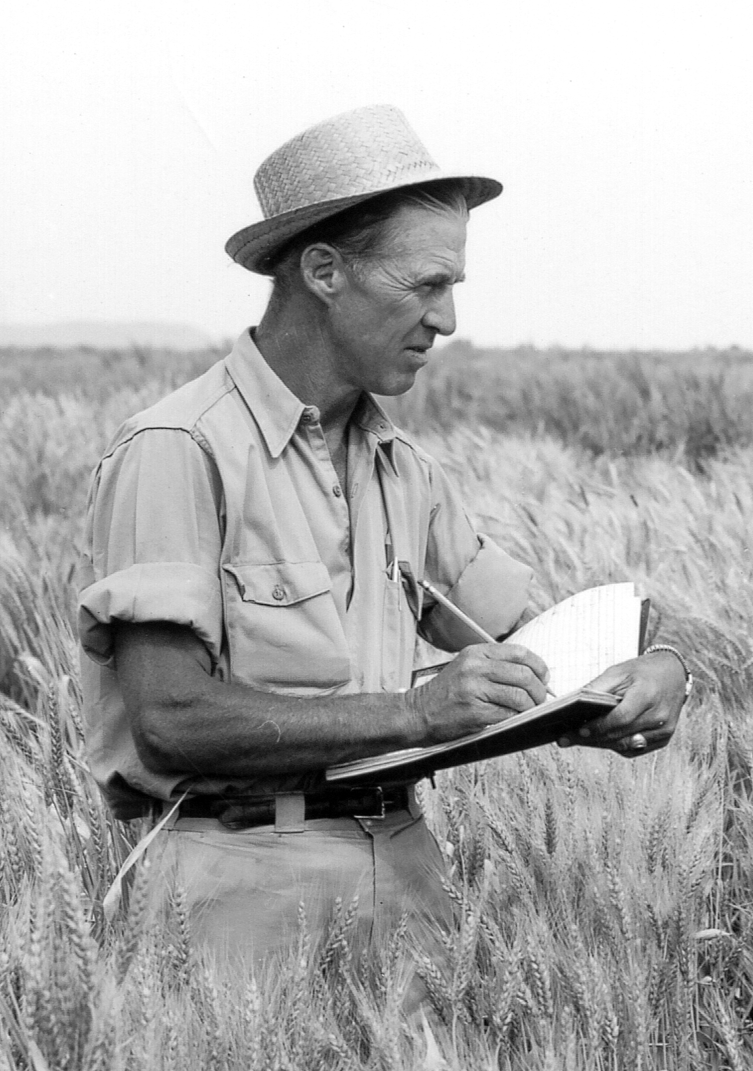
Which of the following people would you say is the most admirable:
Mother Teresa
Bill Gates
Norman Borlaug
Notes:
This pattern of results — that people esteem sacrifice more than impact — also helps us makes sense of the intuition laid bare by Steve Pinker in a 2008 Op-Ed when he asked:
Which of the following people would you say is the most admirable?
While Gates and Borlaug saved many more lives, mother Teresa's sacrifice earns her more intuitive esteem in the eyes of most.

Slide 33
Negative externalities to sacrifice sensitivity?
Donors are extraordinarily sensitive to any whiff of corruption, fraud, or profiteering.
The fall of Dan Pallotta and the Breast Cancer 3-Day walks and AIDS Rides
Notes:
This acute sensitivity to sacrifice not only leads to a perverse distribution of merit, but might also have negative externalities:
>> For example, it could explain why people (over)respond to some kinds of information about charities: Particularly any whiff of corruption, fraud, or profiteering.
>> A case study here is the fall of Dan Pallotta’s for-profit charitable company Pallotta TeamWorks. By 2002, the company was raising $169 million for charity annually, when it was forced to shutdown abruptly when corporate sponsors pulled out amid outrage over Pallotta’s salary — $425,000 and the amount of profit the company was making on it’s fund-raising contracts (4% on ever dollar raised).
At the time Pallotta was quoted as saying:
“We allow people to make huge profits doing any number of things that will hurt the poor, but we want to crucify anyone
who wants to make money helping them.”

Slide 34
Conclusions
The core premise of EA — that all lives have equal value — runs counter to our default psychology
Understanding what motivates people to give could help grow EA in the future
Reputational incentives in particular hold tremendous promise
Notes:
To conclude…
>> Decades of prior work have established that the core premise of EA — that
all lives have equal value — runs counter to our default psychology
>> Understanding what motivates people to give could help us extend the
appeal of EA in the future.
>> Reputational incentives — in particular — hold tremendous promise;
assuming we can learn how to use them.

Slide 35
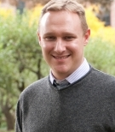
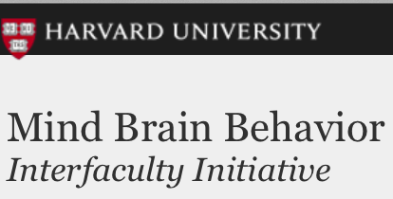

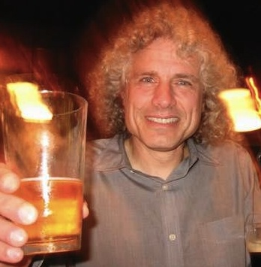
Thanks!
Max Krasnow
Steve Pinker
Notes:
Thanks!

Slide 37
Evidence for partner choice per se
Partner choice survey items:
How intelligent?
How thoughtful?
How friendly?
Notes:
Are nominees deemed more deserving of a humanitarian award also seen as more attractive cooperative partners?
To address this question, subjects answered post-experimental survey questions designed to asses each nominee’s desirability as a cooperative partner.
>> Questions like
>> How intelligent was the nominee?
>> How thoughtful?
>> How Friendly?

Slide 38
Sacrifice
Made
.86
Caring
.70
Skillful
.11
.85
Thoughtful
F1
“Good Partner”
.73
Intelligent
.10
.80
Friendly
.77
.66
Trustworthy
.85
.81
Upstanding
Overall
Deservingness
Generous
Notes:
>> Turns out, OUR 8 face-valid measures of partner desirability
>> load onto a single latent factor,
>> which we chose to call "Good Partner.”
############
And if we include “Good Partner” in a full SEM model,
>> only the Sacrifice factor
>> predicts variance in “Good Partner”
>> And in this model, Sacrifice also directly predicts variance in our main DV (overall deservingness of the award)
>> Both the direct & indirect paths here are significant—indicating a partial mediation.
The takeaway is simply that ratings of overall deservingness do track
ratings of partner desirability...which is consistent with the notion that
we esteem self-sacrificial donors —at least in part— because we value self-sacrifice in potential cooperative partners.

Slide 39
Ruling out scope neglect
That is, maybe the mind cannot distinguish 200 from 1000 meals?
Seems unlikely given we replicated the effect with smaller benefit numbers
(Fed 12 families vs. Fed 60 families)
Notes:
>> Perhaps our effect is an artifact
of the mind’s inability to distinguish 200 meals from 1000?
(while it readily distinguishes 2 days from 10?)
To rule this out, we ran a control condition in which the benefit numbers were more manageable — feeding 12 families compared to 60.
>> The result replicated, this time showing a stronger effect.
[That sacrifice looms larger than benefit also replicated in a version were benefit delivery wassn’t manipulated — but volunteer/donate was, and volunteering was seen as more sacrifiial (as measured by post-experimental questionaire). Turns out the varaince in ratings of deservingness was predicted by ratings of how sacrificial the donor was.]

